Slide 1

CSEN 6101
Requirement Engg. And Design – Q-n-A
Software Engineering (SE) → CSEN3202 – CSE/BTech/6th Semester → Module-I and II → Prepared by : Nilina Bera, CSE, HITK

Slide 2
Software Requirements - Assignments
Fill in the blanks:
The different types of software system requirements are ……………………., non-functional requirements, and …………………..
The notations used to depict information in a data-flow diagram include ………………….., data-flow, ………….and process.
……………. defines a system as a set of objects, which interact with each other by the services they provide.
For an SRS document to be accurate and efficient, it should be correct, ……………………, …………………., and verifiable.
Requirement engineering tools facilitate the organization to ………. and ………. The requirements.
Ans: 1. Functional requirements, domain requirements.
2. External entity, data store
3. object-oriented modeling
4. Unambiguous, complete 5. define, document
Nilina Bera

Slide 3
Software Requirements – Assignments – MCQs
Which of the following is not a step in the requirements engineering process?
a) requirement specification b) requirement analysis
c) feasibility analysis d) requirement prioritization
2. SADT stands for:
a) Software analysis and development technique
b) Structured analysis and design technique
c) System analysis and design technique
d) Structured analysis and development technique
Ans: 1. (d); 2. (b)
Nilina Bera

Slide 4
Software Requirements – Assignments – State True or False
Software can be designed even if the requirements are not correct and complete.
2. Both DFD and flowchart depict the flow of data.
3. An entity diagram depicts a set of real world entities and the logical relationships between them.
The structure of an SRS document changes depending upon the project and requirements.
1. False; 2. False; 3. True; 4. True
Nilina Bera

Slide 5
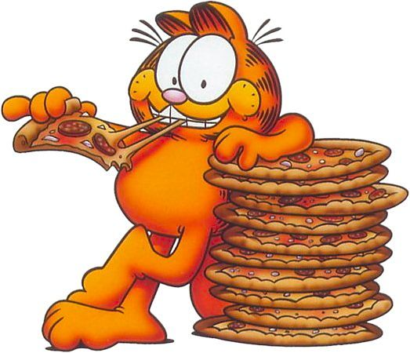
Software Design – Fill in the blanks…..
Software design principles act as a ……………. for the designers to follow a good design practice.
…………. refers to a powerful design tool, which allows software designers to consider components at an abstract level, while neglecting the implementation details of the components.
The way of hiding unnecessary details is referred to as ………………….
Ans. 1. Framework; 2. Abstraction; 3. Information hiding
Nilina Bera

Slide 6
Software Design – MCQ
Various notations that are commonly used are ……………, data-flow diagrams, structure charts, decision table, and program design language.
a) Circles b) Flowcharts c) Gantt charts d) Rayleigh curves
As a design notation, structure charts show the ………. and …….. flow between modules.
a) control and information b) circular and data
c) control and data d) regular and irregular
3. Program design language is a language that is used to specify the system design using natural language (English) along with the constructs of a ………………….
a) Hindi language b) Binary language
c) Programming language d) Both b) and c)
Ans: 1. (b); 2. ©; 3. ©
Nilina Bera

Slide 7
Software Design – State whether true or false
Stepwise refinement is a top-down design strategy used for decomposing a system from a high-level of abstraction into a more detailed (lower level) of abstraction.
Modules should be specified and designed in such a way that the data structures and processing details of one module are accessible to other modules.
Software design is a software engineering phase in which blueprint is developed which serves as a base for the analysis of software system.
The UML is a standard language used in object-oriented design to graphically represent all the system elements.
Evaluating a user interface does not require its prototype to include the look and feel of the actual interface and should offer a range of options.
Ans: 1. True, 2. False, 3. True, 4. True, 5. False
Nilina Bera

Slide 8
Software Design – Descriptive Questions
What is the difference between structure charts and structured flow charts? Explain giving suitable examples and supporting diagrams.
Define module coupling and cohesion. Discuss all types of coupling supported by diagrams.
Explain the relationship between the definition of module interfaces and the design principle of ‘information hiding’.
Imagine that you are the user interface designer responsible for a system that manages the shutdown of a nuclear power station.
a) Comment on the hazards, risks, and reliability
b) What special procedures should be followed during designing?
Nilina Bera

Slide 9
Requirements & Design – Descriptive Questions
What is the difference between structured analysis and object-oriented analysis?
What do you mean by requirement validation and why it is required?
Explain non-functional requirements along with its types as applied on a system. Give examples.
If an analyst has developed the SRS document of a project as a narrative essay, identify the problems that the development team would face later on if it starts its work based on this SRS document.
“It is easy for software engineers to develop software according to user requirements even if they are incomplete as software engineers can consider the user requirements of earlier developed software.” Do you agree with this statement? Why or why not? Give reasons in support of your answer.
Nilina Bera

Slide 10
Requirements & Design – Questions
1. “If data-items EMP-DOB, EMP-SEX and TOT-EARN from module
CALC-EARN are passed on to module CALC-ITAX,
then these two modules are said to have _________ coupling.”
– fill in the blank with the correct choice.
(a) Stamp (b) Data
(c) Control (d) Common
Ans: Data
2. From functional strength point of view the best type of cohesion is
(a) Coincidental (b) Logical
(c) Functional (d) Sequential
Ans: Functional
3. Which is the most important feature of spiral model?
(a) Quality management (b) Risk management
(c) Performance management (d) Efficiency management
Ans: Risk management
Nilina Bera

Slide 11
Requirements & Design – Questions
4. A module is said to have logical cohesion, if
a) it performs a set of tasks that relate to each other very loosely.
b) all the functions of the module are executed within the same time span.
c) all elements of the module perform similar operations, e.g., error handling, data input, data output etc.
d) None of the above.
Ans: C)
5. High coupling among modules makes it
a) difficult to understand and maintain the product
b) difficult to implement and debug
c) expensive to develop the product as the modules having high coupling cannot be developed independently
d) all of the above
Ans: d)
Nilina Bera

Slide 12

Requirements & Design – Questions
6. The deviation of the observed behavior to the specified is called:
Error b) Fault c) Failure d) Defect
Ans: Failure
7. When user requirements are not complete and/or technical issues are not clear which model should be followed for software development?
(a) Spiral Model (b) Waterfall Model
(c) Prototyping Model (d) RAD Model
Ans: Prototyping Model
1. Do you agree with the following assertion? “A design solution that is difficult to understand would lead to increased development and maintenance cost.” Give reasoning’s for your answer.
Nilina Bera

Slide 13
Requirements & Design – Questions
2. What do you mean by the terms cohesion and coupling in the context of software design? How are these concepts useful in arriving at a good design of a system?
3. Is it true that whenever you increase the cohesion of your design, coupling in the design would automatically decrease? Justify your answer by using suitable examples.
4. What do you understand by the term functional independence in the context of software design? What are the advantages of functional independence? How can functional independence in a software design be achieved?
5. What do you understand by information hiding in the context of software design? Explain why a design approach based on the information hiding principle is likely to lead to a reusable and maintainable design. Illustrate your answer with a suitable example.
Nilina Bera

Slide 14
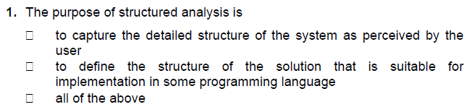
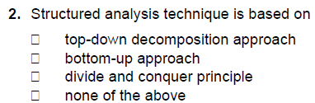
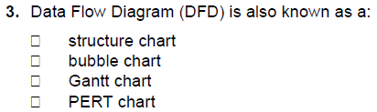
For the following, mark all options which are true.
Nilina Bera

Slide 15
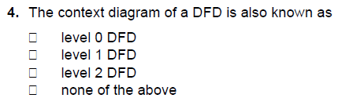
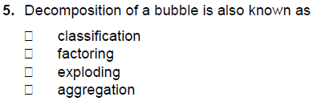
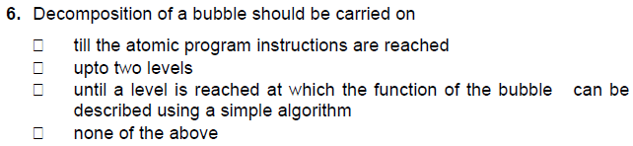
For the following, mark all options which are true.
Nilina Bera

Slide 16
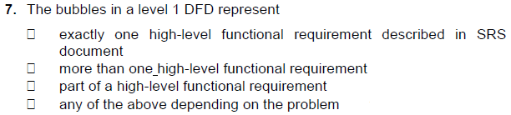
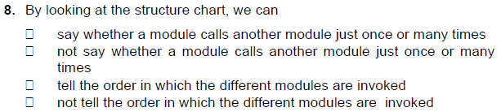
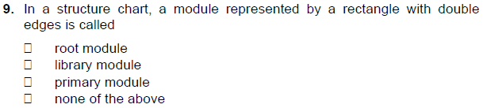
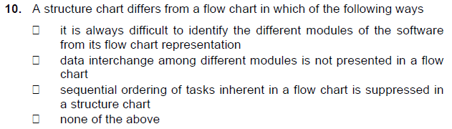
Nilina Bera

Slide 17
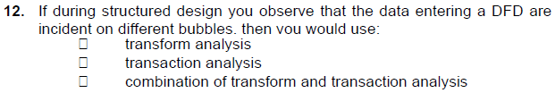
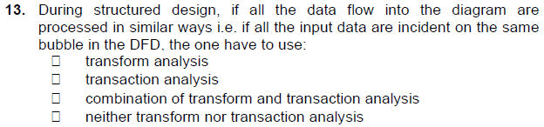
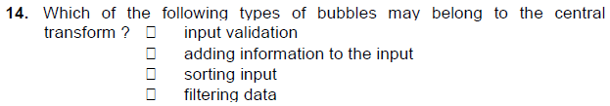
Nilina Bera

Slide 18

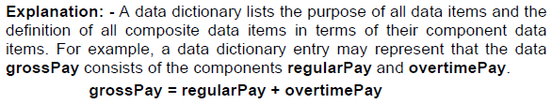
Mark the following as either True or False. Justify your answer.
Nilina Bera

Slide 19
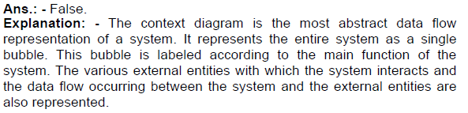


Mark the following as either True or False. Justify your answer.
Nilina Bera

Slide 20
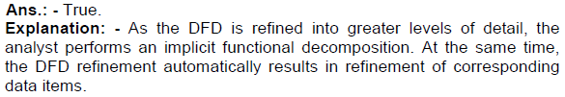
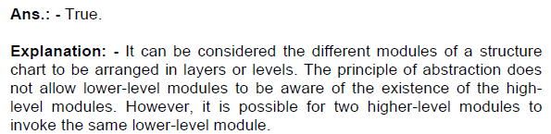
Mark the following as either True or False. Justify your answer.
Nilina Bera

